Slide 1
Guide to repack & use BD Veritor ART test kits

Slide 2
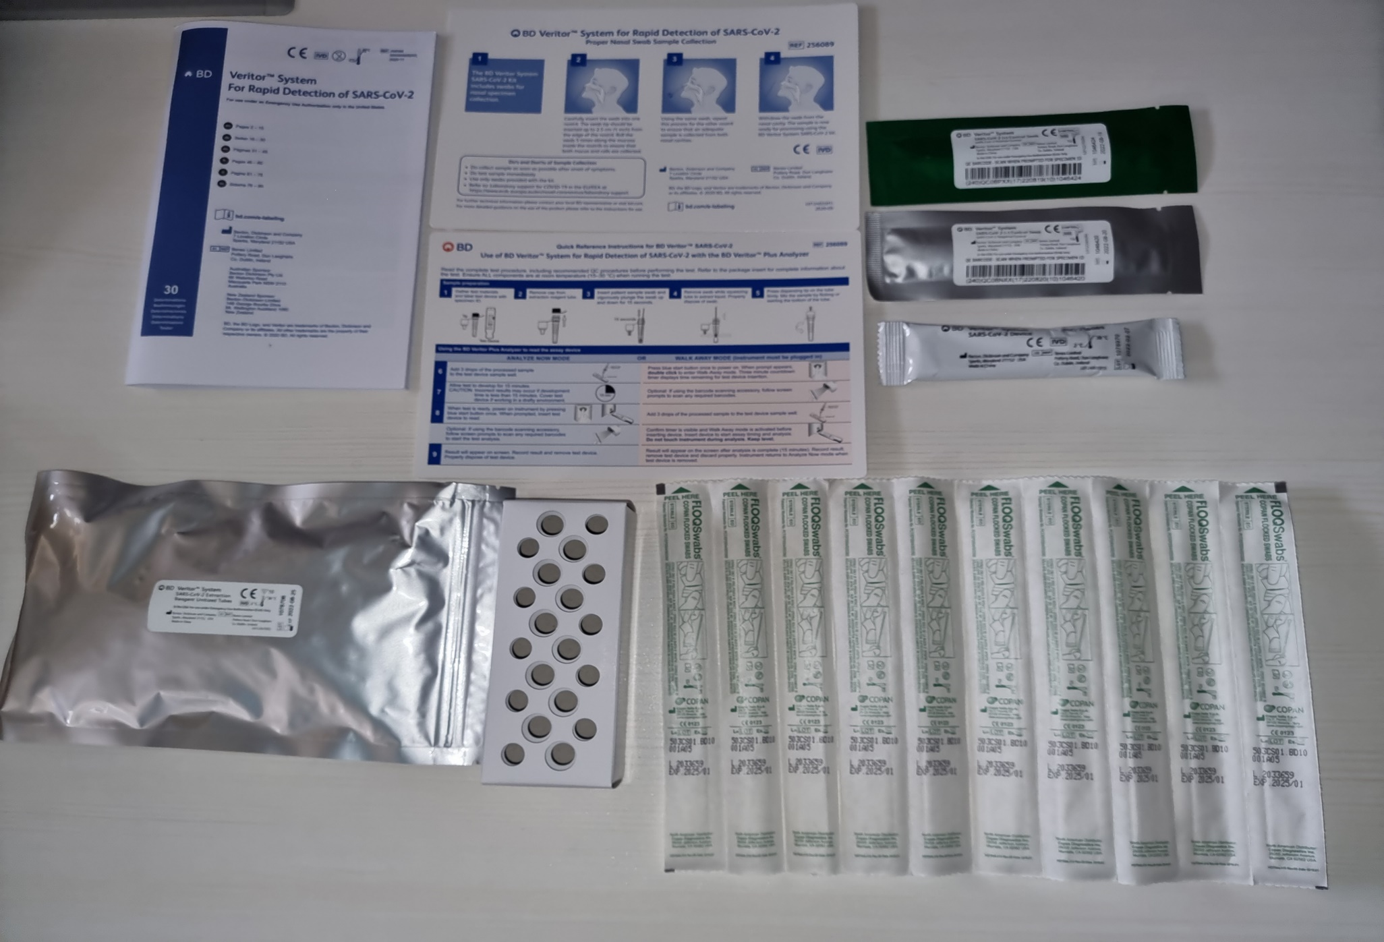
Box Contents
Instruction sheets
BD Veritor System
Test Device
Extraction Reagent (10 in each aluminium pouch)
Specimen sampling swab

Slide 3

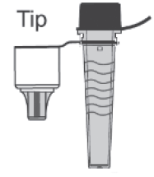



Components required per individual kit
Component | Quantity in Box | Quantity to use or pack per test
BD Veritor System Test Devices | 30 individually packed single use test devices | 1
Extraction Reagent | 30 single use reaction tubes, packed in 10s per aluminium pouch | 1
Specimen sampling swabs | 30 sterile single use swabs | 1
SARS-CoV-2 (+) Control Swab and SARS-CoV-2 (–) Control Swab | 1 each | Not required.

Slide 4
Steps for repacking art kits (IF REQUIRED)
Preparation
Clean packing surface with alcohol wipe.
Put new box of kits on table surface.
Disinfect hands.
Wear face shield, face mask, and gloves. Minimise talking from this point onwards.
Maintain safe distance of 2m between packers.
Packing
Ensure each individual kit has 1x Test Device, 1x Specimen Sampling Swab and 1x Extraction Reagent.
When done with 1 box, disinfect hands with gloves on, using 70% alcohol hand rub.
The Other Items
Discard the buffer rack.
Both the Standard COVID-19 Ag+ Positive Control Swab and the Standard Respiratory Negative Control Swab are not required.

Slide 5
Instructions on how to use BD Veritor
Self-Swab Instructions | PDF File for Printing
English

